Slide 1
Statistical analysis of Covid-19 (SARS-Cov-2)
Mainak Mukherjee
4th Semester
West Bengal State University
Department of Statistics
20/07/2022

Slide 2
Objective :
This dataset has many missing values, and directly applying analysis on the dataset is not possible because it will not provide accurate results and there will be a high chance of biasedness.
Therefore, we first perform data preprocessing. In this step, we will check for missing values based on state and check that there is any missing value for some particular time interval.
Next we will also try to find the relationship between gender (male and female), age group (less than 18-19 to 40-41 to 65 and greater than 65) and current status i.e, (recovered, hospitalized and deceased).
Further, we will try to find out the following dependencies of the said attributes :
Is there any relationship between gender and patient status?
Is there any relationship between patient age and patient status?
Is there any relationship between patient age and patient gender?

Slide 3
About the Dataset :
The dataset has been taken from Kaggle.
There are total of 15 attributes in the dataset.
Except for age, all attribute data types are strings.
In SPSS, we cannot perform any type of analysis on the string datatype.
Therefore, we replace the value of gender, transmission type and current status with nominal data.
The following table will show the change of string value into nominal:

Slide 4
Table 1
 | LABEL | VALUE
 | MALE | 1
GENDER | FEMALE | 2
 | RECOVERED | 1
CURRENT STATUS | HOSPITALIZED | 2
 | DECEASED | 3

Slide 5
Age data are available in integer format,but the value of age ranges between 0 and 100, so it is very difficult to visualize such data. We also divided this attributes into categories and made a new age attribute.
Next, Table 2 will show the change of age value into age group and nominal.

Slide 6
Table 2
Age Range | Age Group | Value
0 to 18 | <18 | 1
19 to 40 | 19-40 | 2
41 to 65 | 41-65 | 3
Greater than 65 | >65 | 4

Slide 7
After filtering the data state wise, we checked the data for missing values. There were a total of 975 cases out of which 183 cases had missing age and gender values. Here, in this analysis we removed these values. To remove the missing values, first we check in which date range we have less missing values. After visualizing the data, we found that from 25/03/2020 to 27/04/2020, and there is very less missing values.

Slide 8
Table 3
Table 3 will show us the total cases in Maharashtra.
VALID |  | FREQUENCY | PERCENTAGE
 | NALE | 464 | 53.0
 | FEMALE | 237 | 27.1
 | TOTAL | 701 | 80.1
MISSING |  | 183 | 19.9
TOTAL |  | 975 | 100.0

Slide 9
Table 4
Table 4 showing the total cases remaining after filtering data with date.
In SPSS, there are many useful commands that can be used to handle missing values. To remove missing values in gender we have used the following command : (gender=1 or gender=2 )
This command selects only those rows where we have gender value either 1 or 2 and all the other rows remain unselected.
VALID |  | FREQUENCY | PERCENTAGE
 | MALE | 362 | 70.7
 | FEMALE | 148 | 28.9
 | TOTAL | 510 | 99.6
MISSING |  | 2 | 4
TOTAL |  | 512 | 100.0

Slide 10
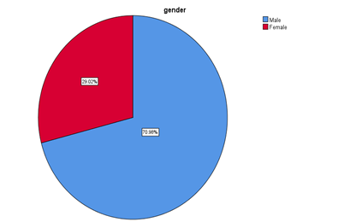
Table 5 : Final dataset used for analysis.
Table 5 shows the statistics after removing all the missing values.
Fig. 1 shows the pie chart of male and female cases.
 |  | FREQ. | PERCENTAGE
VALID | MALE | 362 | 71.0
 | FEMALE | 148 | 29.0
 | TOTAL | 510 | 100.0

Slide 11
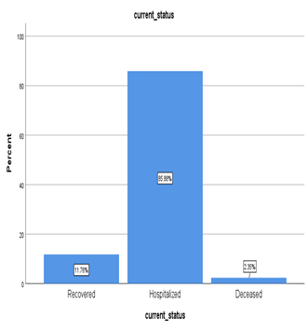
Table 6 : Current status attributes
Table 6 provides us the information related to current status attributes. There are no missing value attributes.
Fig. 2. Bar chart for current status and it can be clearly seen from the bar chart that the majority of cases are hospitalized.
CURRENT STATUS
VALID 510
MISSING 0

Slide 12
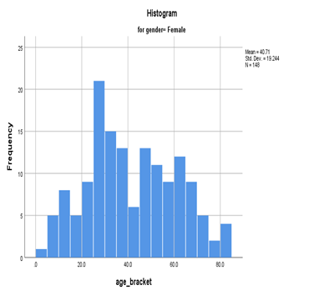
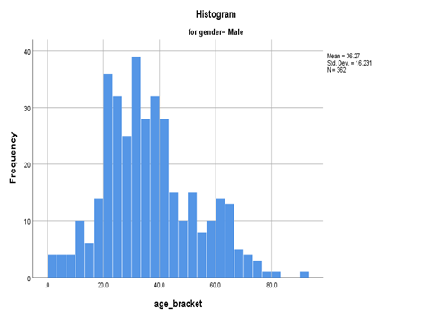
Table 7 : Valid and missing values in age bracket
Table 7 provides the details of the age value in the dataset.
Fig. 3. shows the histogram for male and females respectively.
AGE
VALID 510
MISSING 0

Slide 13
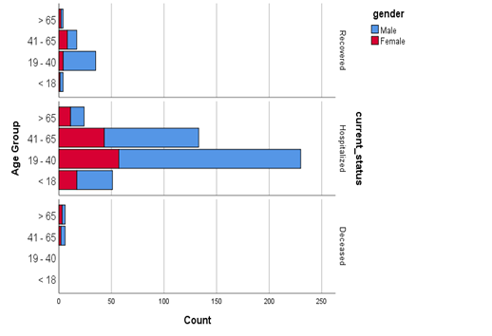
Fig. 6 :
The cases according to the Age group, current status and gender are represented in graphical form in Fig.6.

Slide 14
APPROACH
To solve the research questions, we performed a Chi-square test.
This test is used when we are dealing with nominal or ordinal data and want to find the relationship between the variables.

Slide 15
RESULTS : Chi Square Test
In the Chi square test, we assume two hypothesis, the null hypothesis (h₀) and the alternative hypothesis (h_{a}).
Null hypothesis (h₀) : there is no relationship between the variables.
Alternative hypothesis (h_{a}) : there is a significant relationship between the variables.
If the p value (asymptotic significance) is less than 0.05 then we reject our null hypothesis and if the value is greater than 0.05 then we cannot reject our null hypothesis

Slide 16
Research Questions :
Q1. Is there any relationship between gender and patient status?
A chi square test was performed to determine the relationship between the gender and the patient status. In this test, we want to check whether gender (male and female) has any dependence on current status and vice versa. Now table 8 gives a cross tabulation of gender and current status and Fig. 7 represents the graphical representation. In table 11, the chi square value is calculated and it is 494 which is much higher than 0.05 and so we cannot reject our null hypothesis. We can say that there is no effect of gender on the current status of the patient and vice versa. And in other words current status does not depend upon whether a patient is male or female.

Slide 17
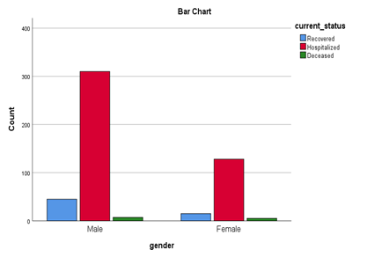
Table 8 : Cross table of gender and current status.
GENDER | CURRENT STATUS |  |  | TOTAL
 | RECOVERED | HOSPITALIZED | DECEASED
MALE | 45 | 310 | 7 | 362
FEMALE | 15 | 128 | 5 | 148
TOTAL | 60 | 438 | 12 | 510

Slide 18
Research Questions
Q2. Is there any relationship between Age group and patient status?
Similar to our First question, we will also use the chi square test to determine the relationship between age group and current status. In this test, we want to check whether the age group has any dependencies on current status or vice versa. Table 9 gives the cross tabulation of age group and current status and Fig. 8 represents the graphical representation. In table 11, the value of chi square is calculated and it is 0.000, which is less than 0.05 and so we reject our null hypothesis. We can say that there is an effect of age group on the current status of the patient and vice versa.

Slide 19
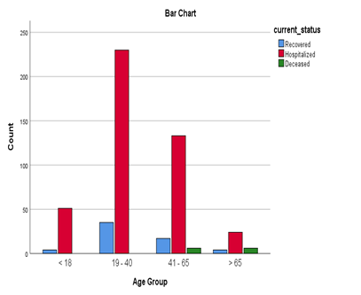
Table 9 : Cross table of age group and current status.
AGE | CURRENT STATUS |  |  | TOTAL
GROUP | RECOVERED | HOSPITALIZED | DECEASED
<18 | 4 | 51 | 0 | 55
19-40 | 35 | 230 | 0 | 265
41-65 | 17 | 133 | 6 | 156
>65 | 4 | 24 | 6 | 34
TOTAL | 60 | 438 | 12 | 510

Slide 20
Research Question
Q3. Is there any relationship between age group and gender?
A chi square test is also performed to determine the relationship between age group and gender. In this test, we want to check whether the age group has any dependencies on gender and vice versa. Table 10 gives the cross tabulation of age group and gender and Fig. 9 represents the graphical representation. And in table 11 the chi square value is calculated and it is 0.007 which is less than 0.05, so we reject our null hypothesis. We can say that there is an effect of age group on the gender of the patient and vice versa.

Slide 21
Table 10 : Cross table of age group and gender.
AGE GROUP | GENDER |  | TOTAL
 | MALE | FEMALE
<18 | 37 | 18 | 55
19-40 | 204 | 61 | 265
41-65 | 103 | 53 | 156
>65 | 18 | 16 | 34
TOTAL | 362 | 148 | 510

Slide 22
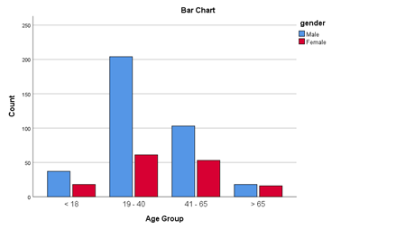
Table 11 : Chi square value for Maharashtra
 | p VALUE
GENDER AND CURRENT STATUS | 0.494
AGE GROUP AND CURRENT STATUS | 0.000
AGE GROUP AND GENDER | 0.007

Slide 23
Conclusion :
Covid-19 is increasing daily, and it is very important to analyse these data. In this study, Maharashtra state covid-19 patients data were analysed to determine the relationship between different variables. In table 11 Maharashtra results shows that there are dependencies in age group and current status and in age group and gender only in gender, and current status variables are independent.

